Slide 1
Familiarize yourself with phishing attacks
HR & Marketing

Slide 2
What is phishing?
Phishing is a social engineering act where the perpetrator or attacker attempts to deceive individuals into providing sensitive information.
This information may include usernames, passwords, credit card numbers, and other Personal Identifiable Information (PII)
The attacker masquerades as a trustworthy entity or insider in emails, websites, and even text messages.

Slide 3
Key features of phishing
Impersonation: Attackers often pretend to be reputable companies, financial institutions, or even trusted contacts
Urgency: The body of the message (and sometimes, the email title) often creates a sense of urgency, claiming that an account will be closed or suspended unless a specific action is taken (e.g., clicking a link and adding personal details)
Links to fraudulent websites: These emails contain links (sometimes masked in action texts) to harmful or fraudulent websites designed to look legitimate. The sites often capture login credentials.
Request for Personal information: Victims are asked to enter PII or other sensitive information that can be used for fraudulent activities.

Slide 4
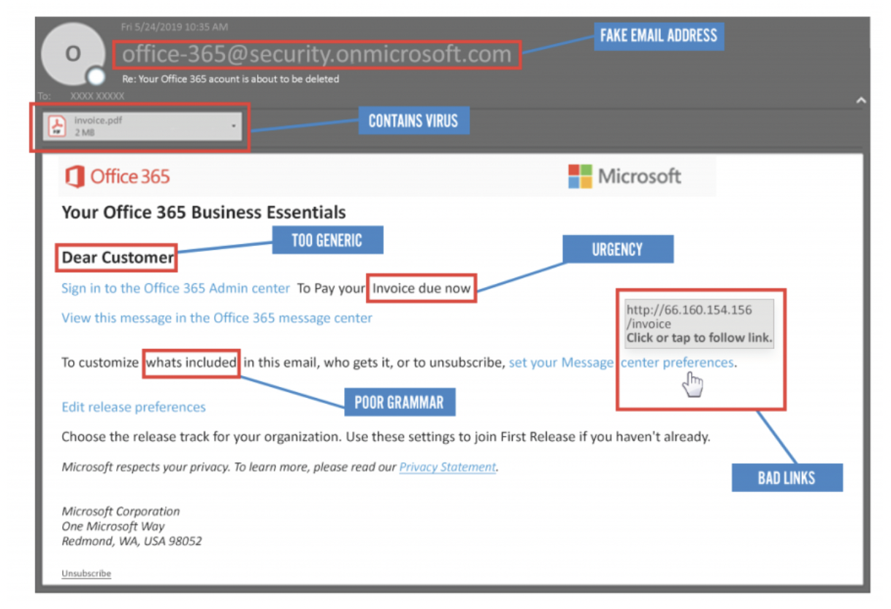
Learn to spot phishing emails
<think of an effective way to show examples of the tactics used in phishing emails>
Image: How to spot phishing emails
URL: 7 Ways to Detect a Phishing Email (linkedin.com)

Slide 5
How do we stop getting phished?
Do due diligence on the email sender and the message from unsolicited email addresses
Always hover over links to see the actual URL before clicking to ensure it matches a legitimate search
Be skeptical
Report any suspicious email to IT and Management
Regularly take updated training on phishing and other cybersecurity threats on the company’s intranet.

Slide 6
Remember
Check the URL of the website.
Always be suspicious of any email requesting personal information.
Use a password manager to securely store unique passwords for each website.
Use a secondary/side channel to double-check when someone requests you to do something

